Slide 1
Project 3 : AIML – UT, Austin
Advanced Machine Learning: Credit Card Users Churn Prediction
Date : November 20, 2024

Slide 2
Contents / Agenda
Executive Summary
Business Problem Overview and Solution Approach
EDA Results
Data Preprocessing
Model performance summary for hyperparameter tuning.
Appendix

Slide 3
Executive Summary
Total Transaction Count, Total Revolving Balance, Total Relationship Count, Total Transaction Amount, and Total Count Change from Q4 to Q1 are identified as the top five reasons for customer attrition at Thera Bank, here are tailored recommendations to address each factor and reduce the likelihood of customer churn:
Targeted Promotions and Rewards, Seasonal or Limited-Time Offers, Balance Transfer Offers, Customer Engagement, Loyalty Programs, Exclusive Services for Multi-Product Customers, Increase Engagement During the Holiday Season, Customer Segmentation are some of the recommendations, we can think of to increase Thera Bank’s credit card customers.

Slide 4
Business Problem Overview and Solution Approach
Business Problem:
Thera Bank has recently observed a significant decline in the number of credit card users, which could lead to a loss of revenue. Credit cards are a critical source of income for the bank due to various fees charged, including annual fees, balance transfer fees, late payment fees, and others. Customers discontinuing their credit card services could significantly impact the bank's profitability.
The objective is to predict which customers are at risk of leaving (attriting) the credit card services, identify the reasons for attrition, and enable the bank to take proactive actions to improve customer retention.
Key Challenge:
To develop a classification model that will accurately predict whether a customer will leave the bank’s credit card services ("Attrited Customer") or remain an active user ("Existing Customer"). By understanding the key drivers of attrition, the bank can tailor its services, offerings, and communication strategies to reduce customer churn and retain valuable customers.

Slide 5
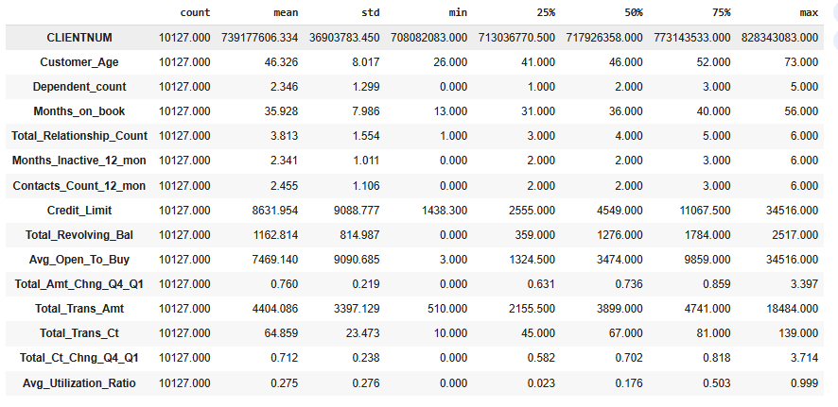
EDA Results
The majority of customers fall within the age range of 30 to 60 years.
On average, customers have been using the bank's services for 36 months (3 years).
The average credit limit for customers is $8,600, and they spend an average of $4,400 monthly, with an average of 64 transactions per month.
Link to Appendix slide on data background check

Slide 6
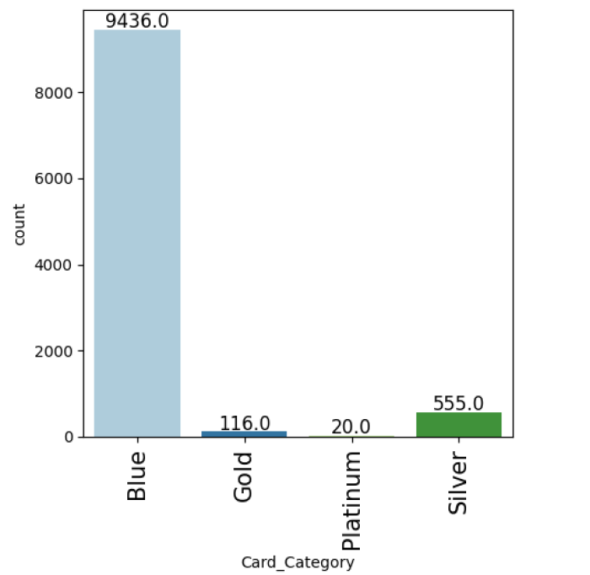
EDA Results
The majority of customers hold a blue credit card. We should conduct a survey to understand why customers prefer not to choose gold, silver or platinum credit cards.
Link to Appendix slide on data background check

Slide 7
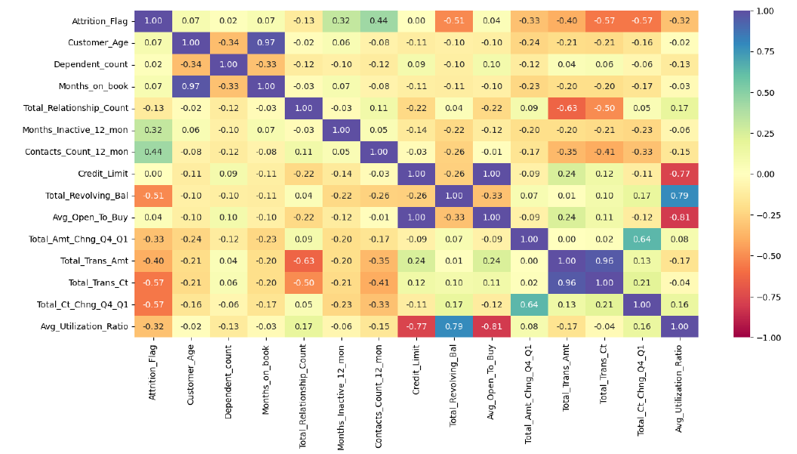
EDA Results
Total_Amt_Chng_04_01 Vs. Attrition Flag : A moderate negative correlation indicates that customers who significantly increased their spending from Q4 to Q1 are less likely to churn.
Total_Trans_Ct Vs. Attrition Flag: A strong negative correlation suggests that customers who make more transactions are less likely to churn.
Total_Ct_Chng_04_01 Vs. Attrition Flag : A strong negative correlation suggests that customers who significantly increased their transaction frequency from Q4 to Q1 are less likely to churn.
Based on the other stacked plots, it appears that marital status, education level, and dependent count have a minimal effect on the attrition rate.

Slide 8
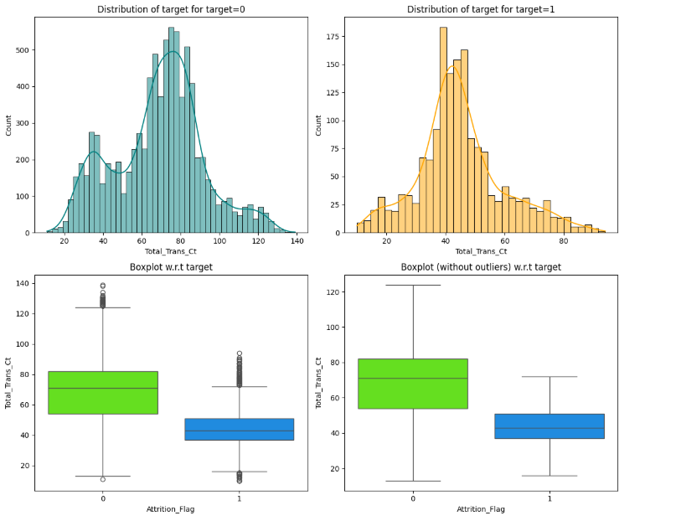
EDA Results
The total transaction count has an impact on the attrition rate.
Link to Appendix slide on data background check

Slide 9
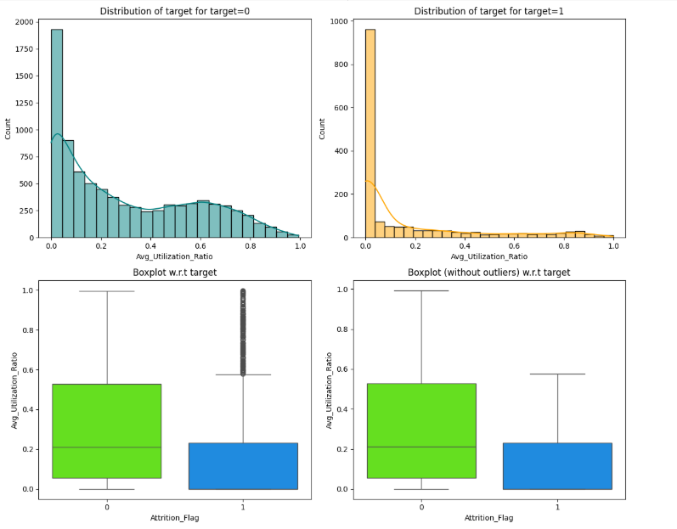
EDA Results
Customers with more credit card utilization are less likely to leave the bank's services.

Slide 10
Data Preprocessing
Duplicate value check – There are no duplicate values in the dataset.
Missing value treatment – There are missing values in Education level, Income categoty and Martitial status category. With pandas dumties, those categories are encoded. In income category, the abc value is replaced with NA.
Outlier check (treatment if needed) - Some individuals have very high credit limits, and their transactions involve large amounts. No outlier treatment is required for these cases.
Feature engineering – We are dividing the data into 80:20 – 80% goes for training the model and 20% goes for testing.
Data preparation for modeling – it is a classification problem. We need to predict correctly the customers which are likely to attrite the service. Also, we need to make sure that the model reduce False Negative.
Note: You can use more than one slide if needed

Slide 11
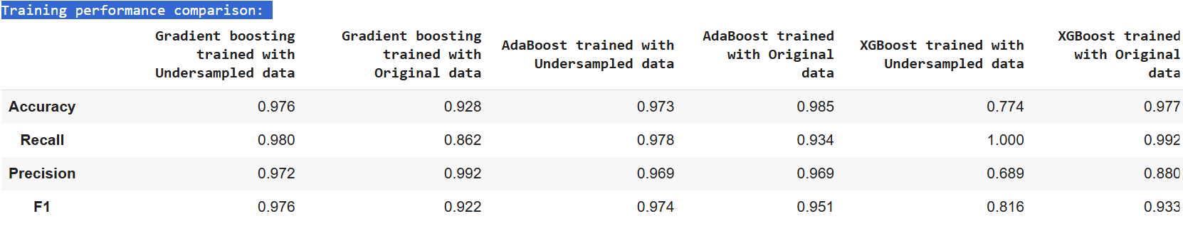
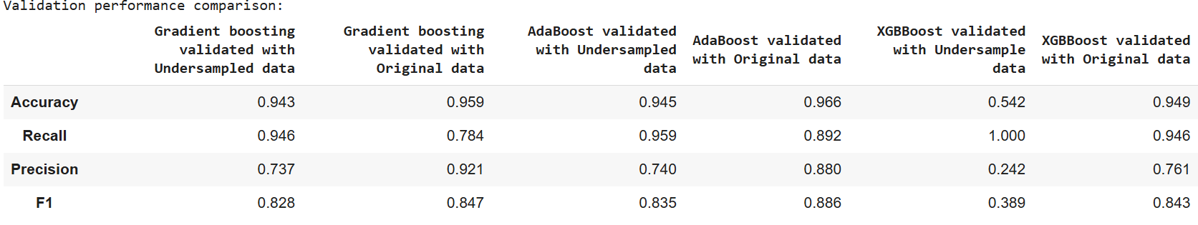
Model Performance Summary
Summary of performance metrics for training and validation data in tabular format for comparison for tuned models

Slide 12
Model Performance Summary
The XGBoost model demonstrated strong performance on both the training and validation datasets, achieving a recall rate of over 94%, which is a critical metric for banks to retain potential customers. The GBoost model performed well in terms of recall on the training dataset but showed slightly weaker results on the validation dataset. Meanwhile, the AdaBoost model performed well on both the training and validation datasets.
Overall, the XGBoost model with tuned hyperparameters emerged as the best option.
To further enhance the recall metric of the XGBoost model, we can apply oversampling techniques, which can boost the recall rate to nearly 100%.
Link to Appendix slide on model assumptions

Slide 13
APPENDIX

Slide 14
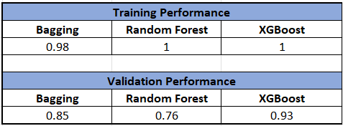
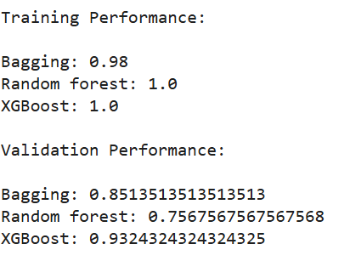
Model Performance Summary (original data)
Observations:
Training: All three models exhibit near-perfect performance on the training data, with Random Forest and XGBoost achieving a recall score of 1.0.
Validation:
XGBoost outperforms both Bagging and Random Forest on the validation set, demonstrating a higher ability to generalize to unseen data.
Bagging shows a significant drop in performance from training to validation, suggesting potential overfitting on the training data.
Random Forest exhibits a similar trend to Bagging, with a noticeable decline in performance on the validation set.
Conclusion:
Based on the validation performance, XGBoost appears to be the most robust model among the three, as it demonstrates the best ability to generalize to unseen data.
Link to Appendix slide on model assumptions

Slide 15
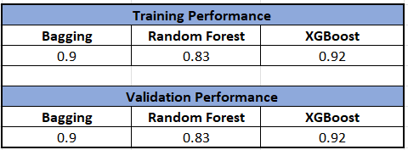
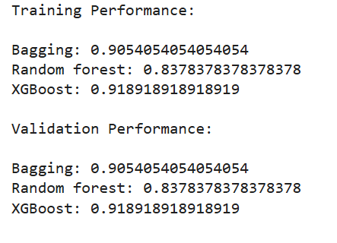
Model Performance Summary (oversampled data)
Observations:
Training: All three models exhibit similar performance on the training data, with Bagging having the highest recall score.
Validation: The performance of all three models remains consistent with their training performance, indicating that they are not overfitting.
Conclusion:
Based on the validation performance, XGB appears to be the most robust model among the three, as it demonstrates the highest recall score on both training and validation sets.
Link to Appendix slide on model assumptions

Slide 16
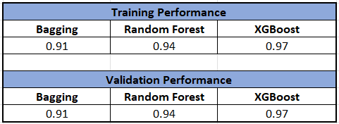
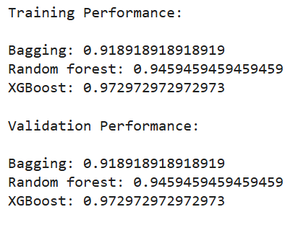
Model Performance Summary (undersampled data)
Observations:
Training: All three models exhibit similar performance on the training data, with XGBoost having the highest recall score.
Validation: The performance of all three models remains consistent with their training performance, indicating that they are not overfitting.
Conclusion:
Based on the validation performance, XGBoost appears to be the most robust model among the three, as it demonstrates the highest recall score on both training and validation sets.
Link to Appendix slide on model assumptions

